Slide 1
The Software Testing Pyramid: A Concrete Example
Jim Weaver
Vanderbilt University Medical Center
(weaver.je@gmail.com)
Source Code and Tests
https://github.com/weaverj/testpyramidexample
Selenium tests: Cindy Leffler, VUMC

Slide 2
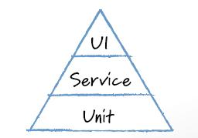
Mike Cohn’s Test Pyramid
Foundational base of unit tests.
Minimum necessary tests through user interface.
Service testing in the middle – testing services provided by the application independent of the UI.
Notes:
Automated test distribution by purpose and type.
Google has similar concept for testing – Small, Medium, Large (Unit, Integration, System).

Slide 3
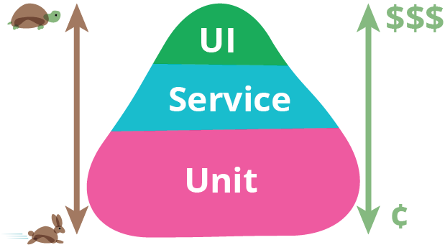
Motivations
UI tests are slower, more brittle, expensive.
Many teams observed with high percentage of automated tests through the UI.
Unit tests are easy for developers to write, usually in same language as application.
Application logic can be tested independent of UI in Service level tests.

Slide 4
The Three Layers of the Pyramid
 | Unit | Service | UI
Appropriate Purpose | Test Units of Code, Aid with Design and Code Quality | Test Business Logic / Services | Test the User Interface
Authors | Developers | Customers and Developers | QA automation or Developers
Speed / Cost | Fast / Low | Fast to Medium / Medium | Slow / High
Notes:
Service – business logic of application – responds to inputs with outputs. (Calculator example from Cohn article).
Cohn, 2009: “a service is something the application does in response to some input or set of inputs.”
Orthogonal Concepts: Integration Tests, End to End tests. Decide what the above layers mean to your team.

Slide 5

Challenges
Intentional Planning and Effort
Shared Understanding
Communication and Collaboration
Notes:
Not going to happen by happy accident. What tools will be used, how to divvy up test coverage for a feature across those tools without gaps or duplication – all requires intentional work and communication.
This presentation: Look at sample app based on real-world clinical application and its tests – see how pyramid constructed, discuss process and tools that were used for real application’s tests.

Slide 6
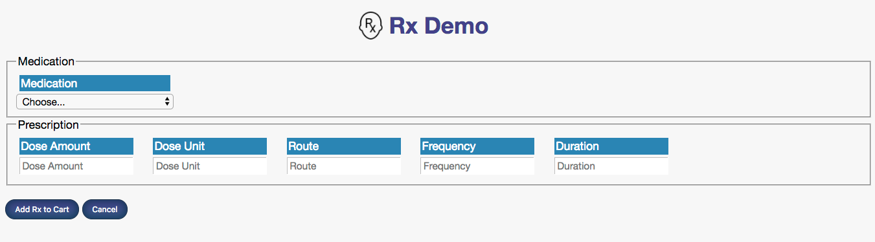
Sample Application
Rx Demo: Web-based Prescribing Application, extracted from real clinical app in production for over a decade.
Notes:
Testing crucial for clinical applications at VUMC – apps are used directly for patient care.
Spend a lot of time thinking about testing strategies, tools, improving automation.
Sample prescribing web app, derived from real app, only has one feature, but shows some of this care and intention regarding testing.

Slide 7
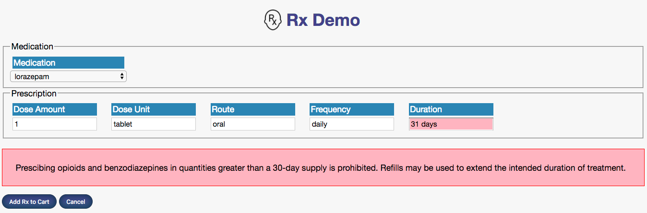
Feature: Limit Opiate Rx Duration
When clinician is prescribing Opiates or Benzodiazepines, limit the duration of the prescription to 30 days or under.
Notes:
Simple feature to state, but there are a number of aspects to implement.
Must identify opiates
Must recognize number of days from text entered by user
Must apply business rule based on these two components and inform user

Slide 8

Feature Test Plan
Feature Part | Unit (Junit/Jasmine) | Service (Fitnesse) | UI (Selenium + Junit)
Identify if drug being prescribed is Opiate or Benzo
Calculate number of days for duration
Rule applied to prescription and appropriate response built
Inform user in UI if rule violated
Notes:
Team for real application often discussed testing details – what will be tested in which medium, authored by whom.
Notice mini-pyramid shape for just this one feature.
UI-centric tests only needed to test UI behavior, not the business rules for identifying opiates, calculating duration, or applying the rule to a particular perscription.
The testing tools at each level were ones used by real application team – note that tools don’t dictate level / granularity of tests – all three could be done with unit testing tool. Fitnesse is chosen for service testing by this team due to visibility and participation of customers.

Slide 9
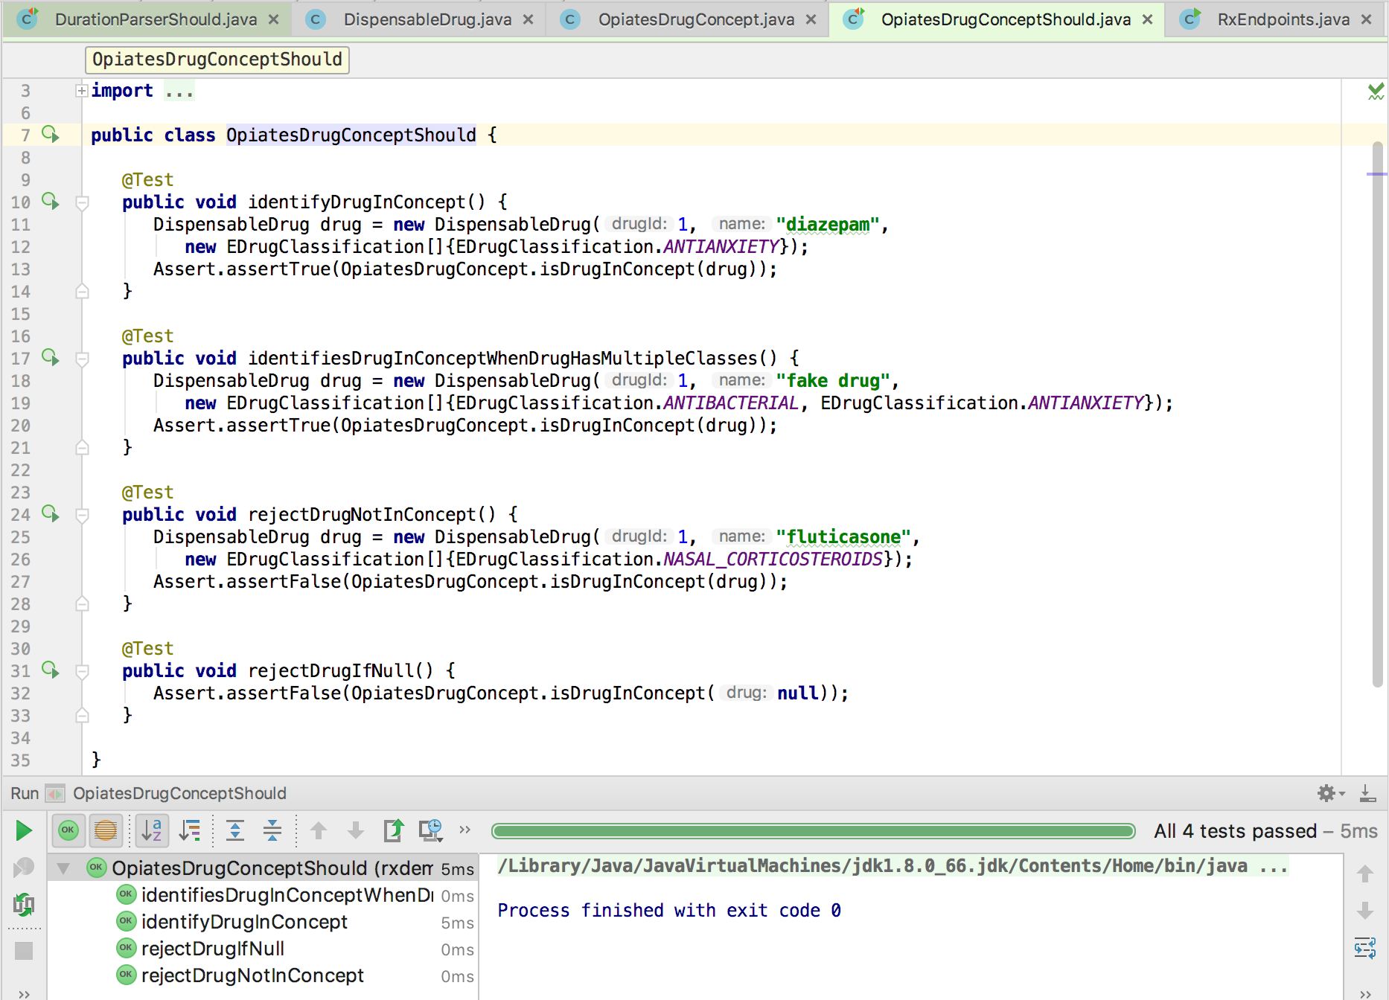
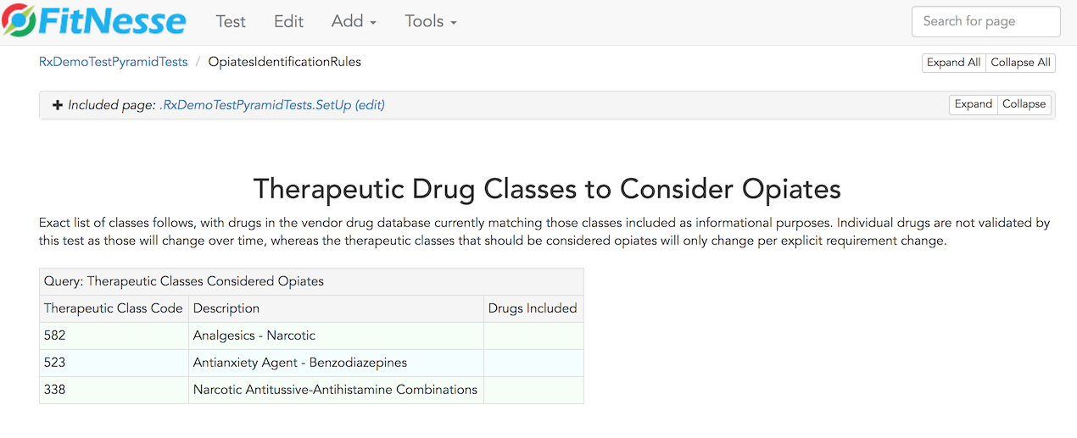
Identify Opiates / Benzos
Feature Part | Unit (Junit/Jasmine) | Service (Fitnesse) | UI (Selenium + Junit)
Identify if drug being prescribed is Opiate or Benzo
Test source
Test source
Notes:
The fitnesse tests covers the full requirements for this part of the feature – specifies each drug classification that should be considered an opiate.
OpiatesDrugConceptShould states and tests the design of the classes used to determine if a drug is in this class. DispensableDrug, EDrugClassification, and OpiatesDrugConcept classes interact to implement this feature.
Unit test is testing the design and implementation of the units of code supporting this part of the feature, fitnesse is specifying and testing the requirements for this part of the feature. There is little overlap or duplication between the tests for this reason – they complement, not duplicate one another.

Slide 10
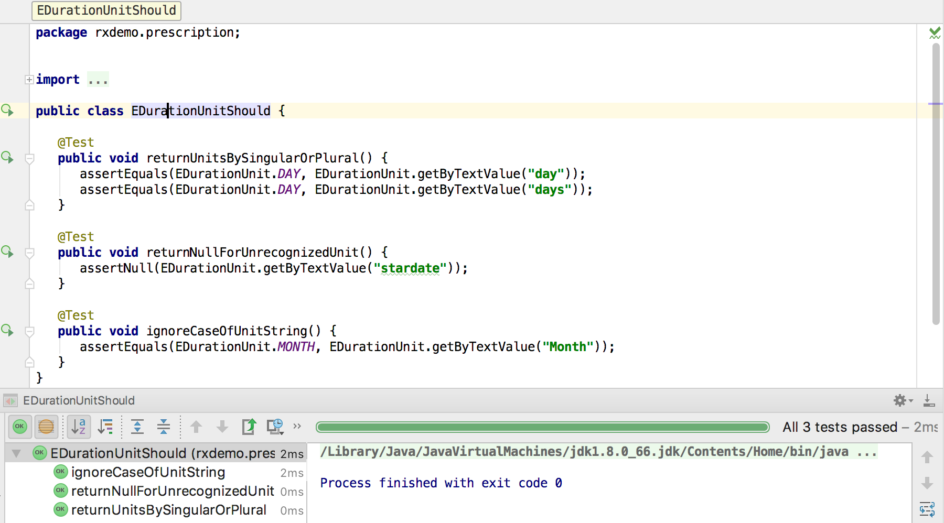
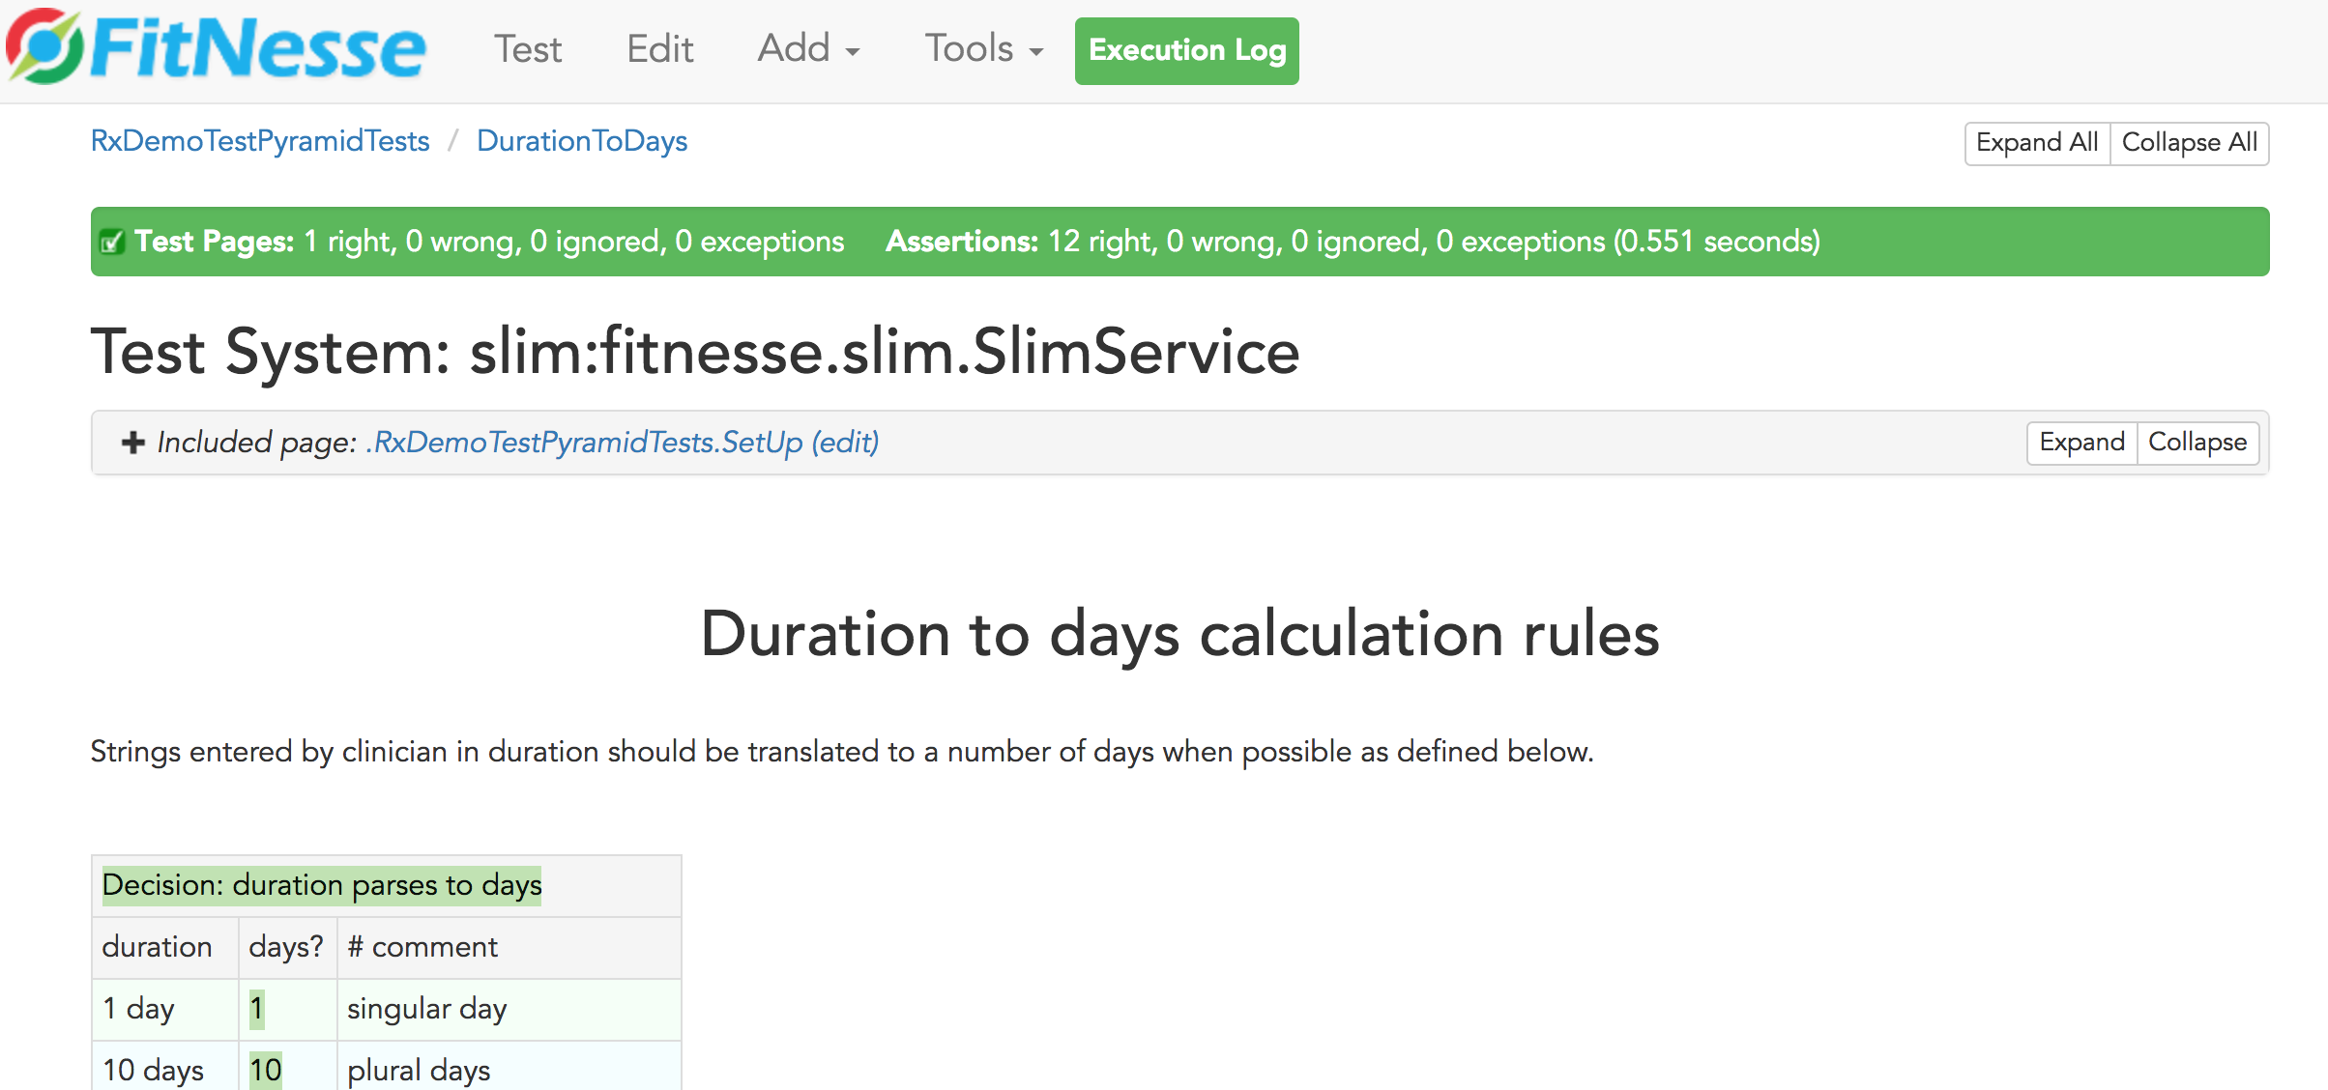
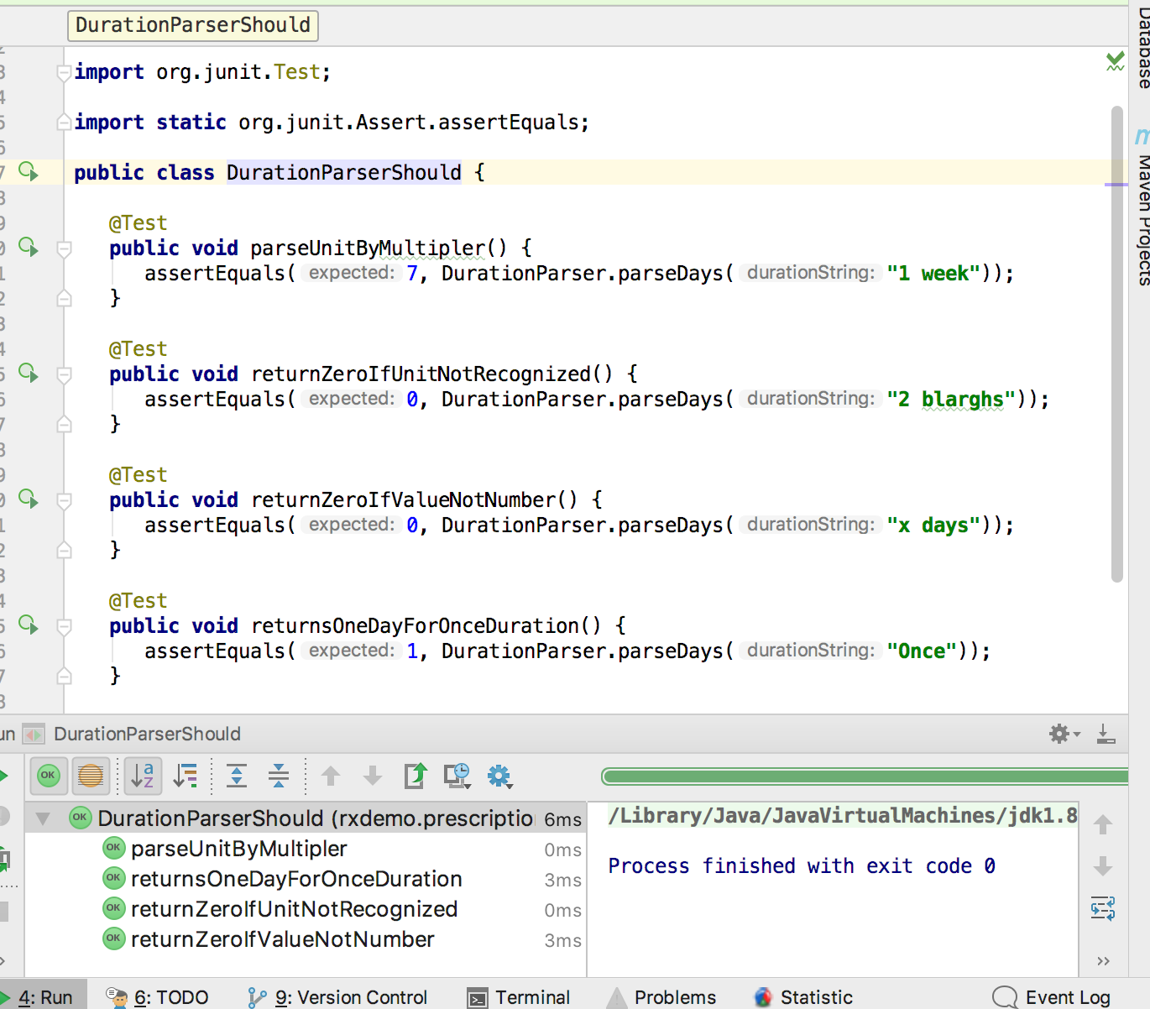
Calculate Duration in Days
Feature Part | Unit (Junit/Jasmine) | Service (Fitnesse) | UI (Selenium + Junit)
Calculate number of days for duration
DurationParserShould
DurationToDays
EDurationUnitShould
Notes:
The fitnesse test covers a wide variety of parsing scenarios.
Two classes provide the implementation for this part of the feature, EDurationUnit and EDurationParser. EDurationUnit test verifies how duration units are expressed. The test for EDurationParser covers a few of the duration calculation scenarios covered in the fitnesse test, but not the full range – small amount of overlap.

Slide 11
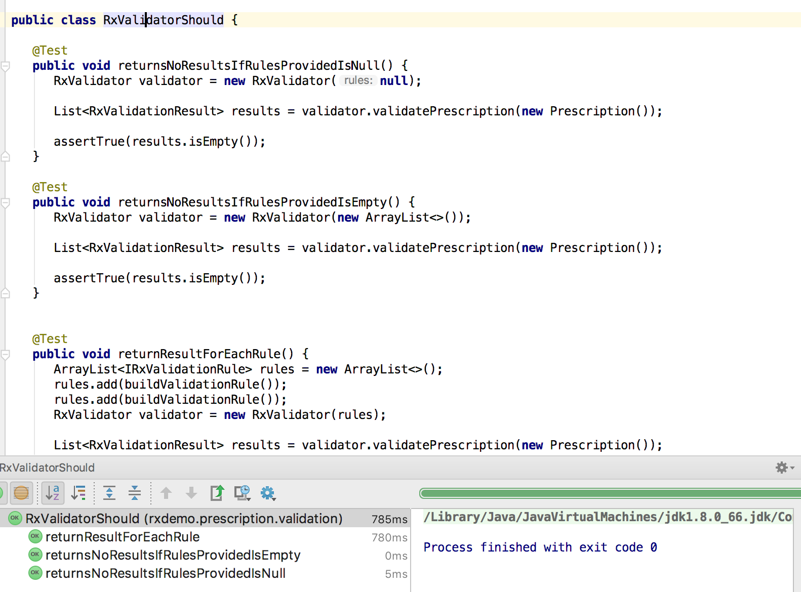
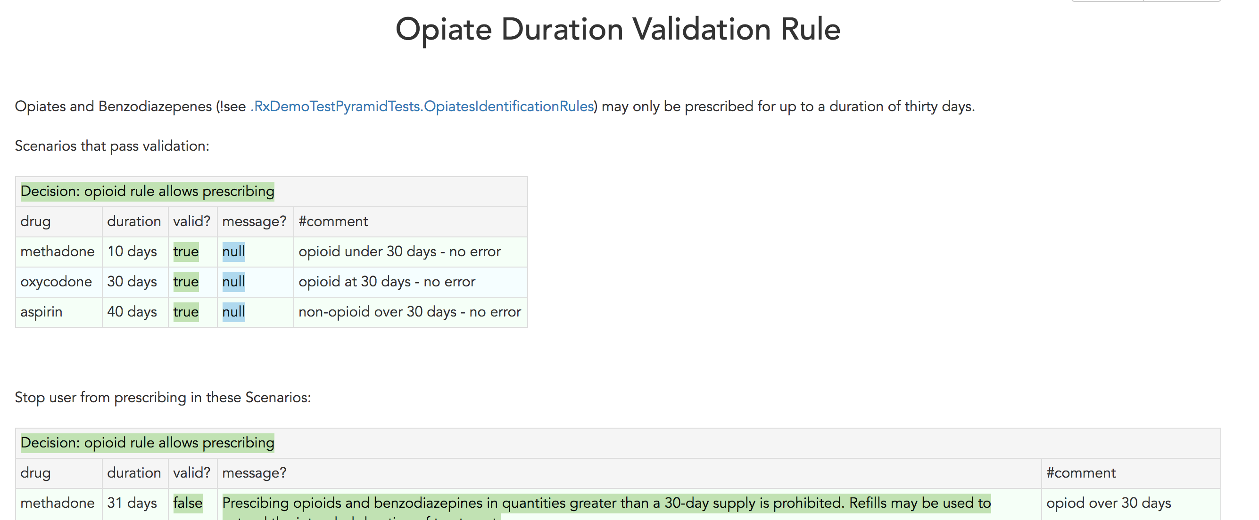
Duration Validation Rule Applied
Feature Part | Unit (Junit/Jasmine) | Service (Fitnesse) | UI
Rule applied to prescription and appropriate response built
RxValidatorShould
OpiateDurationRule
OpiateDurationValidationRuleShould
ValidatePrescriptionCommandShould
Notes:
The fitnesse test covers a full range of cases which will both pass and fail the validation rule. It depends on both opiate identification and duration parsing logic.
RxValidator is a class for running multiple validation rules, represented by IRxValidationRule interface, against a prescription. Each rule will return an RxValidationResult that indicates whether the prescription is valid with respect to that rule, and if not what message should be displayed and which prescription fields are related to the failure if any. The RxValidatorShould unit test verifies this rules runner functions correctly, but using fake rules.
ValidatePrescriptionCommand is the initial class invoked to run all prescription validation rules when a prescription is sent from a client browser. It runs all the rules and returns a response to the client. ValidationPrescriptionCommandShould tests this class with fake rules.
OptateDurationValidationRuleShould tests the validation rule used for this feature. It tests a few scenarios, including edge case like a null drug, but does not cover all business scenarios as they are covered by fitnesse test.

Slide 12
Inform User in UI if Rule Violated
Feature Part | Unit (Junit/Jasmine) | Service (Fitnesse) | UI (Selenium / Java)
Inform user in UI if rule violated |  |  | OpiateUnder30Allowed OpiateOver30NotAllowed
RxValidatorShould
App.spec.js
RxValidationResponseHandler.spec.js
Notes:
The fitnesse test covers a full range of cases which will both pass and fail the validation rule. It depends on both opiate identification and duration parsing logic.

Slide 13
Team Process and Habits
Notes:
Specific activities that helped achieve healthy pyramidal mix of tests for the real prescribing app.

Slide 14
References
Succeeding with Agile: Software Development Using Scrum by Mike Cohn, Addison-Wesley, 2009
The Forgotten Layer of the Test Automation Pyramid: Mike Cohn, 2009.
TestPyramid: Martin Fowler, 2012.
Small, Medium, Large: Mike Bland, 2011.

